Slide 1
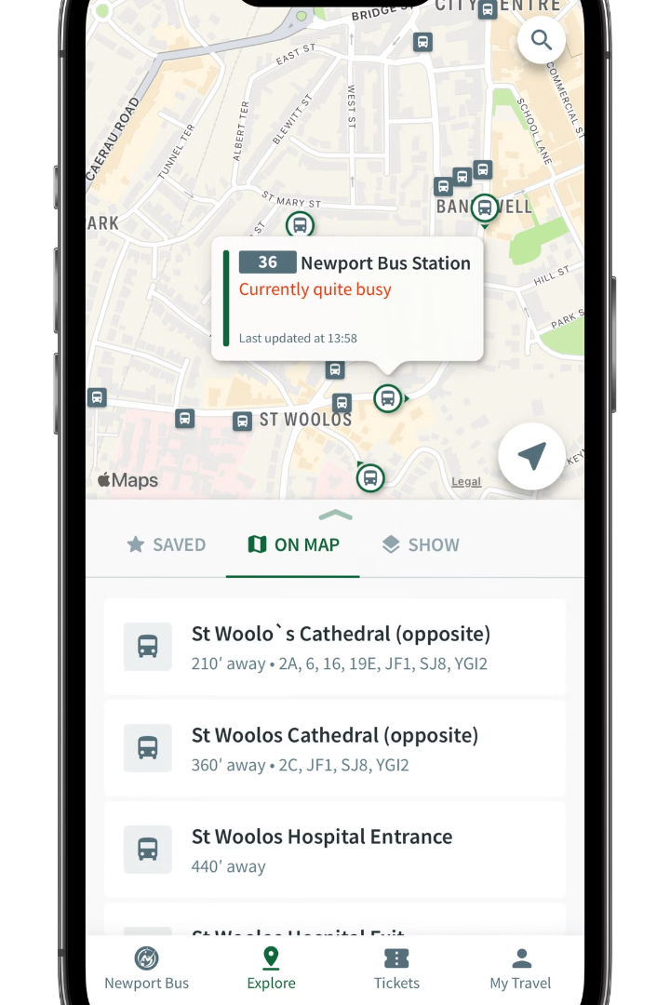

Introduction to Bus Ticketing and Payment System
Discover the innovative technologies transforming the public transportation experience. This comprehensive system streamlines ticket purchasing, fare management, and passenger analytics for seamless, efficient bus travel.
by Vishnu Sai .P
192211432

Slide 2
Importance of Efficient Bus Ticketing Solutions
Improved Passenger Experience
Increased Revenue
Streamlined ticketing and contactless payment options enhance convenience and reduce wait times, leading to a more enjoyable journey for bus riders.
Automated fare collection and real-time passenger data analytics help bus operators optimize pricing, reduce fare evasion, and maximize revenue generation.
Operational Efficiency
Environmental Benefits
Digitized ticketing systems enable better resource planning, fleet management, and data-driven decision-making to improve overall operational efficiency.
Paperless ticketing and contactless payment reduce the carbon footprint associated with traditional ticket printing and handling.

Slide 3
Key Features of a Bus Ticketing and Payment System
Contactless Payments
Mobile Ticketing
Real-Time Passenger Data
Integrated Fare Management
Passengers can purchase and display tickets directly on their smartphones, eliminating the need for physical tickets and enhancing convenience.
Seamless boarding and fare collection through tap-and-go NFC technology, mobile wallets, and bank cards, reducing delays and physical touchpoints.
Advanced analytics provide bus operators with valuable insights on passenger trends, travel patterns, and revenue data to optimize operations.
Unified payment systems that enable seamless travel across different modes of public transportation, simplifying the passenger experience.

Slide 4
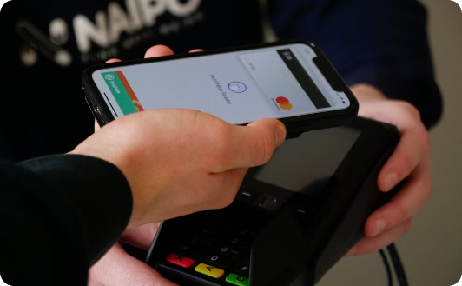
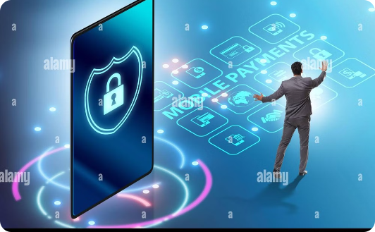
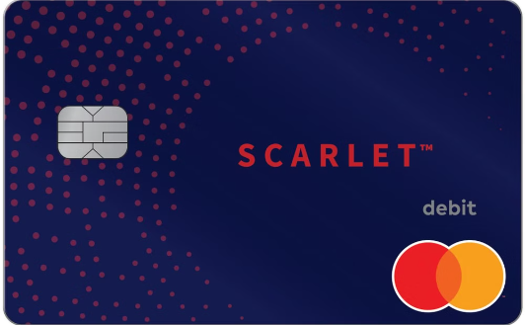
Contactless Payment Options
Tap-and-Go NFC
Mobile Wallets
Contactless Bank Cards
Passengers can quickly board buses and pay fares by tapping their credit/debit cards or mobile wallets equipped with Near-Field Communication (NFC) technology.
Integrated mobile ticketing apps allow passengers to securely store payment methods and purchase tickets directly on their smartphones for a seamless boarding experience.
Passengers can use their contactless-enabled bank cards to pay for bus fares, eliminating the need to carry cash or physical tickets.

Slide 5
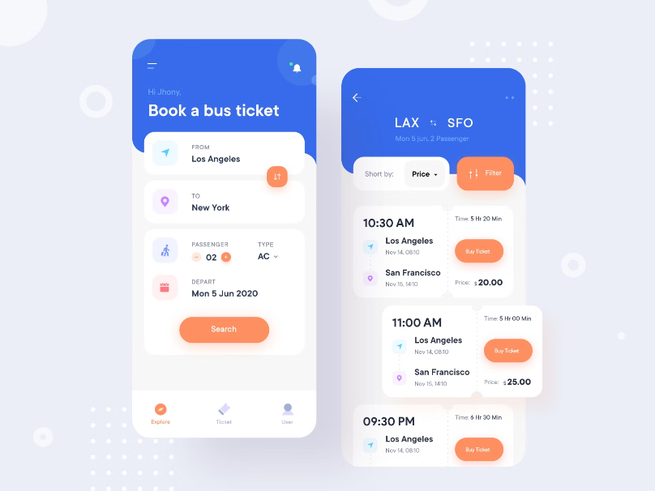
Mobile Ticketing and App-based Solutions
Innovative mobile ticketing apps revolutionize the bus travel experience, allowing passengers to purchase and display tickets conveniently on their smartphones. These seamless digital solutions streamline the boarding process, reduce queues, and provide real-time journey information at their fingertips.
Integrated mobile payment options, such as digital wallets and QR code scanning, further enhance the convenience, ensuring a frictionless and contactless transaction for passengers. Advanced features like multi-modal trip planning, real-time schedule updates, and push notifications keep riders informed and empowered throughout their journey.

Slide 6
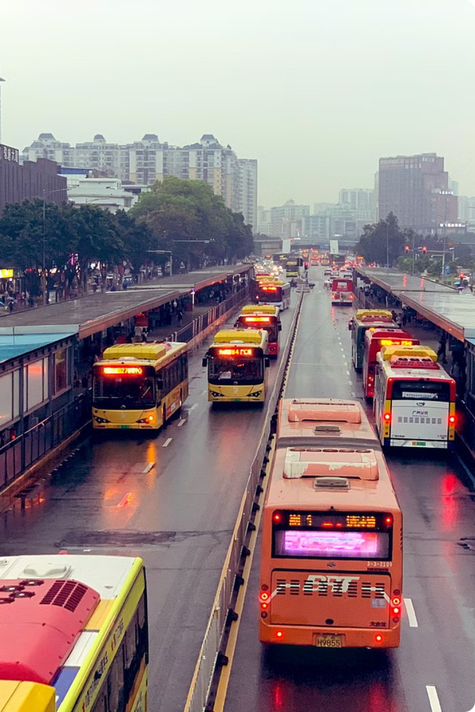
Integrated Fare Management Systems
Integrated fare management systems enable seamless, multimodal travel by allowing passengers to use a single payment method across different modes of public transportation, such as buses, trains, and subways.
These unified systems streamline the passenger experience, eliminating the need to purchase separate tickets or manage multiple payment cards. Advanced features like capped fares, fare aggregation, and embedded loyalty programs further enhance the convenience and affordability of public transit.

Slide 7
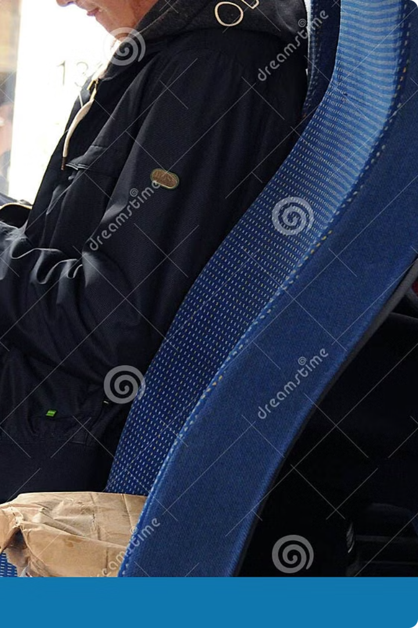
Real-time Passenger Information and Analytics
Advanced bus ticketing systems leverage real-time data to provide passengers with up-to-the-minute journey information. Riders can access estimated arrival times, service disruptions, and trip planning details directly on their smartphones through intuitive mobile apps.
For bus operators, integrated analytics platforms aggregate passenger data to generate valuable insights. These data-driven tools enable smarter route planning, dynamic fare adjustments, and targeted service improvements to enhance the overall transportation network.

Slide 8




Challenges and Considerations in Implementation
Security and Privacy
System Integration
Accessibility
User Adoption
Seamless integration with existing infrastructure, legacy systems, and multiple transportation modes is essential for a cohesive user experience.
Ensuring the system is inclusive and accessible for all passengers, including those with disabilities or limited digital literacy.
Engaging passengers and promoting the benefits of the new system to drive widespread adoption and encourage behavioral change.
Robust security measures are crucial to protect sensitive passenger and payment data. Compliance with data privacy regulations must be maintained.

Slide 9
Benefits for Passengers and Bus Operators
Enhanced Passenger Experience
Increased Ridership
Streamlined ticketing, contactless payments, and real-time information create a more seamless, convenient, and enjoyable journey for bus riders.
Improved accessibility and user-friendly technology encourage more people to use public transportation, leading to higher passenger volumes and revenues.
Operational Efficiencies
Environmental Benefits
Automated fare collection, route optimization, and data analytics help bus operators improve resource allocation, reduce costs, and deliver better services.
Paperless ticketing and reduced reliance on physical infrastructure contribute to a smaller carbon footprint and more sustainable public transportation systems.

Slide 10




Future Trends and Innovations in Bus Ticketing
Contactless Payments
AI-Powered Analytics
Mobility as a Service
Digital Inclusion
Innovative solutions will ensure equitable access and enable underserved communities to benefit from advanced ticketing technologies.
Widespread adoption of mobile wallets, tap-and-go NFC, and QR code scanning will drive a cashless, frictionless boarding experience.
Advanced data analytics and AI-driven insights will help optimize routes, predict demand, and personalize the passenger experience.
Integrated Mobility-as-a-Service (MaaS) platforms will enable seamless multimodal journey planning and payments across public and private transport.

